Slide 1
MODELLING OF FLIPKART
SESSION 2013 - 2014
INTERNATIONAL INSTITUTE OF INFORMATION TECHNOLOGY , BANGALORE (IIIT-B)

Slide 2
GUIDED BY:
Prof. K.V. Dinesha
PREPARED BY:
Ankit Narang (MT2013014)
Nikhil Agrawal (MT2013090)
Paras Mittal (MT2013097)

Slide 3
Objective Of The Project
Objective of our project is to implement some of the vital features of Flipkart so as to model the functioning of this site to some extent and to incorporate the use of certain RESTful web services. Major features are:
Login / Signup ,Feedback ,Place Order , Notification , Stock Management , Deal of the day
Similarly , other such services will be used such as login into this site using Facebook login and other additional services using RESTful services. Also, our modeled system will be deployed using Google App Engine.

Slide 4
Functionality
Flipkart is a website that facilitates online shopping. The customers may shop with the help of their registered Flipkart account or without it by using their email ID. Some of the main features that highlight Flipkart are Cart, Place Order, Account Management, Wallet, Return Order, Browse through the products as an analogous user- until login/asked for email for purchasing items, etc. another vital feature of the site is its ability to use some of the most recent technologies- RESTful Web Services.
REST uses concept of uniform interface and HTTP protocol is being used as a communication protocol in RESTful web services. It uses 4 main HTTP methods :
GET , POST , PUT , DELETE

Slide 5
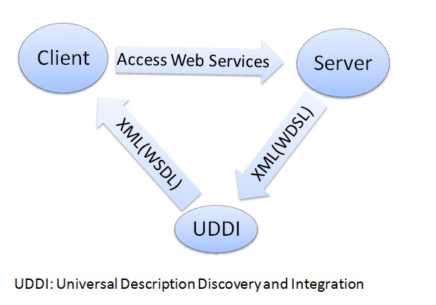
Functionality(Contd…)

Slide 6
Technology / Architecture :
Technologies used :-
Eclipse - Kepler Service Release 2
MySql Database v 5.2.38
Apache Tomcat 7.0.50
REST Web services
Deployment using Google App Engine
Architecture:-
REST architecture and Struts 2 Framework

Slide 7
Standard to be followed throughout Project
All the Standard Software engineering principles are being followed and maintained:
Version Control , revision Control is being maintained on timely basis.
Timesheets on regular basis
Minutes of Meeting of Weekly Meeting
Weekly Status Report
All Standard rules are followed during implementation, coding, and testing.

Slide 8
Brief summary of work done
Formulation of the problem
Reading relevant background information, understanding and documenting the requirements
Designing a solution, documentation
Dividing the selected uses cases among group members
Documentation on FlipKart with all use cases,their design diagrams,Flow of events,Implementation Strategy etc.
Relevant Learning
Struts 2 framework + JSP implementation
Implementation of Student Information System(mini project) and FlipKart using Struts2

Slide 9
Plan for remaining work
Relevant Learning
Reading relevant background information on RESTful architecture , web services
Getting acquainted with Google App Engine.
Coding and Testing
Implementation of 4 RESTful web services that will be used by our FlipKart and Integration with other group’s FlipKart
Integration Testing and System Testing
Re-work and debugging after receiving final reviews from the Mentor

Slide 10
Software engineering processes / tools / methods used
Version Control and Integration
Git Hub is being used for the version control as well as for the integration of our project.
Link: https://github.com/ParasMittal/SE_Project
Link: https://github.com/Live-Oak/FlipKartOOAD
Revision Control
Project Management Report is being made bi-weekly for the revision control on project.
Also , Minutes of Meeting, Timesheet entry is being maintained continuously on timely basis.
Testing Strategies
Preparation of test cases , testing modules has been divided among the group members and will be started once the implementation is over.

Slide 11
THANK YOU

